Slide 1


Office Sponsored Programs (OSP)
Pre-Award Administration
Cayuse SP Proposal Routing Instructions

Slide 2
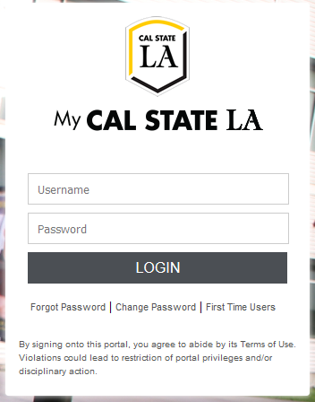
Cayuse Login: https://uascalstatela.cayuse424.com/
Username: Your Cal State LA ID (eg. LastName123)
Password: Your single sign-on Cal State LA password

Slide 3
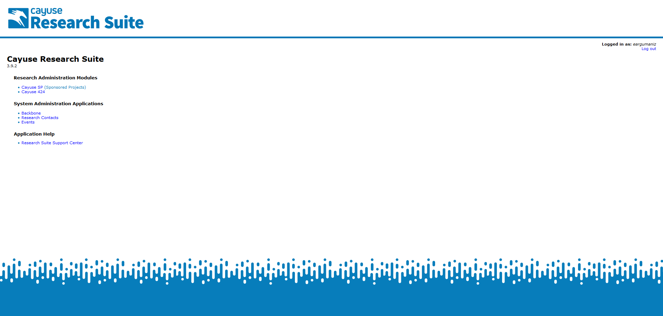

Slide 4
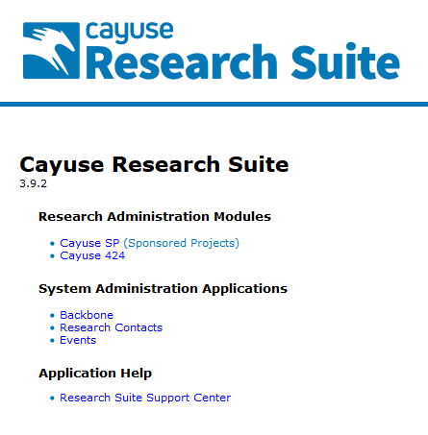
Click the
Sponsored Projects
link

Slide 5
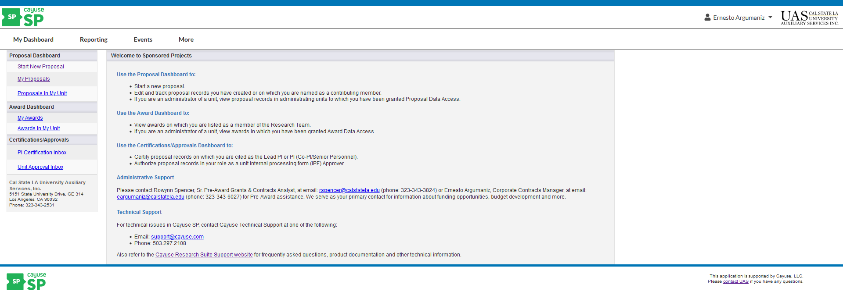
To start the internal routing process, click Start New Proposal

Slide 6
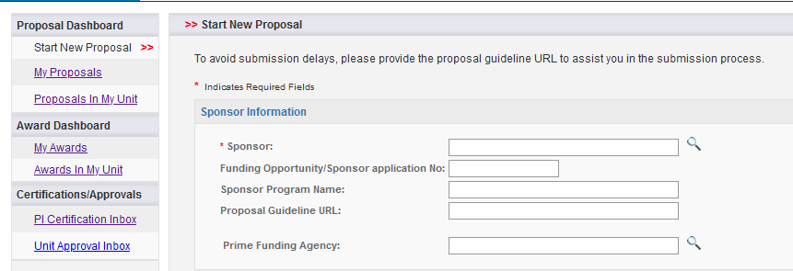
Sponsor Information
Sponsor: This is usually the sponsor whose name will be on the check to UAS, or to whom UAS will send invoices. If the sponsor is not listed, please contact Ernesto Argumaniz (eargumaniz@calstatela.edu) or Rowynn Spencer (rspencer@calstatela.edu) to add a record for the sponsor.
Proposal Guideline URL: Add the link to the funding announcement or opportunity
Prime Funding Agency: Enter the name of the prime funding agency if UAS is receiving a subgrant or subcontract from an intermediate source. For example, if NIH awards a grant to ABC University, and ABC University awards a subgrant to UAS, then NIH would be the prime funding agency.

Slide 7
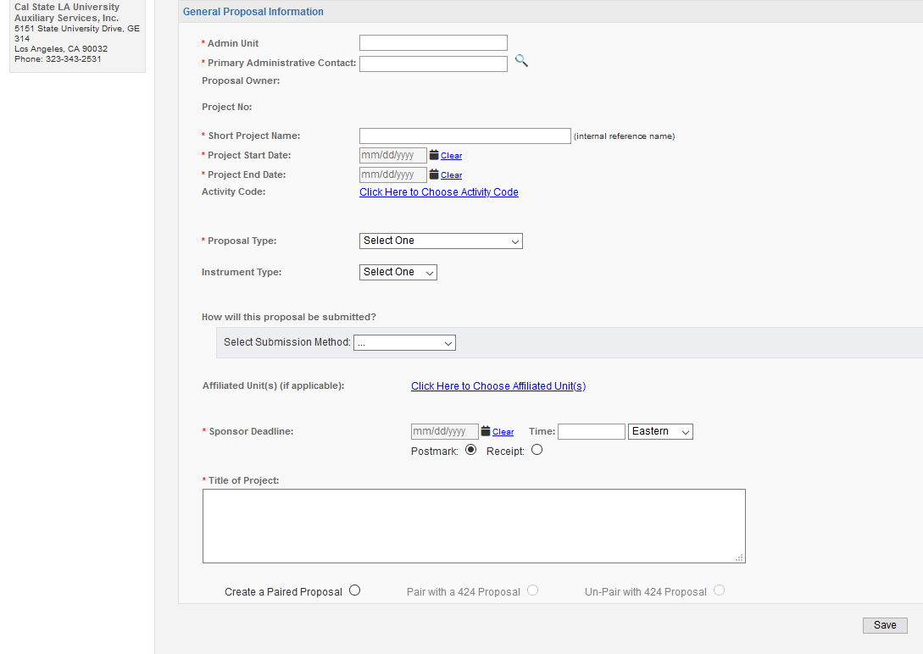
General Proposal Information
Admin Unit: Select the Department of the Lead Principal Investigator is affiliated with.
Primary Admin Contact: Select the Lead Principal Investigator’s Name
Short Project Name: The short project name is for internal reference only and helps the Pre-Award Administration match a proposal to a PI (i.e. John Smith – DoD)
Project Start and End Date: Add entire project performance period
Activity Code: Select the type of Project – Other or Research & Development
Proposal Type: Select the type of Proposal – New, Preliminary, Supplement, Resubmission/Amendment, Revision, Renewal, or Recurring Contract
Instrument Type: Select the type of Award type – Grant, Contract or Subcontract
Select Submission Method: Select the submission method – Cayuse424, Grants.gov forms, FastLane, Sponsor Website, Email, Paper, or Other
Sponsor Deadline: Add the day and time of the Sponsor Deadline
Title of Project: Title of Project. It will be submitted to Sponsor
Save to Move Forward!

Slide 8
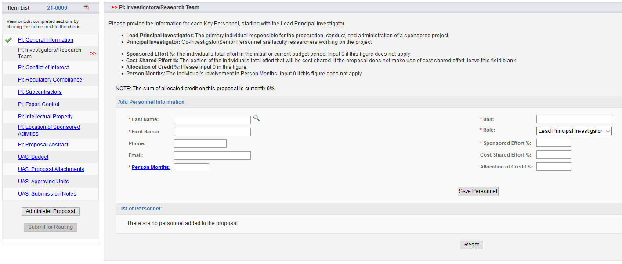
Investigators/Research Team
Add all Cal State LA faculty involved in the project. Include faculty at no cost.
Save each Personnel

Slide 9
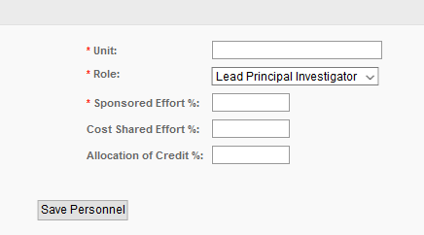
Investigators/Research Team
Role: Assign the role of the “Lead Principal Investigator” to the primary individual responsible for the preparation, conduct, and administration of the project. All other Cal State LA faculty should be assigned the role of “Principal Investigator” to include them in the routing process.

Slide 10
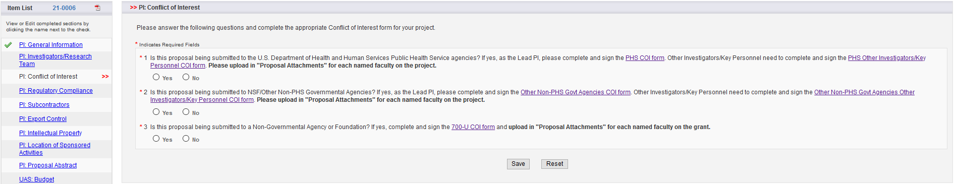
Conflict of Interest
Lead Principal Investigator and all faculty must complete and sign the appropriate conflict of interest for the proposal and return to the UAS Office Sponsored Programs (OSP) Pre-Award Administration.
Save to Move Forward!

Slide 11
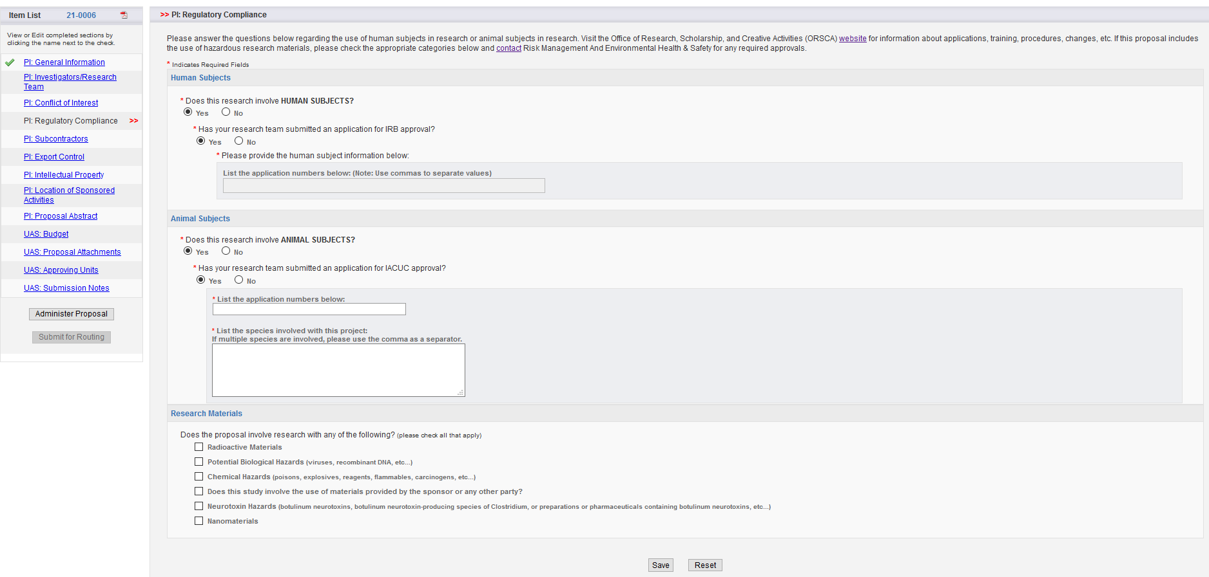
Regulatory Compliance
Answer the questions regarding the use of human (IRB) or animal (IACUC) subjects in the project.
If your proposal has any Research Materials, please contact Risk Management and Environmental Health & Safety for approval.
Save to Move Forward!

Slide 12
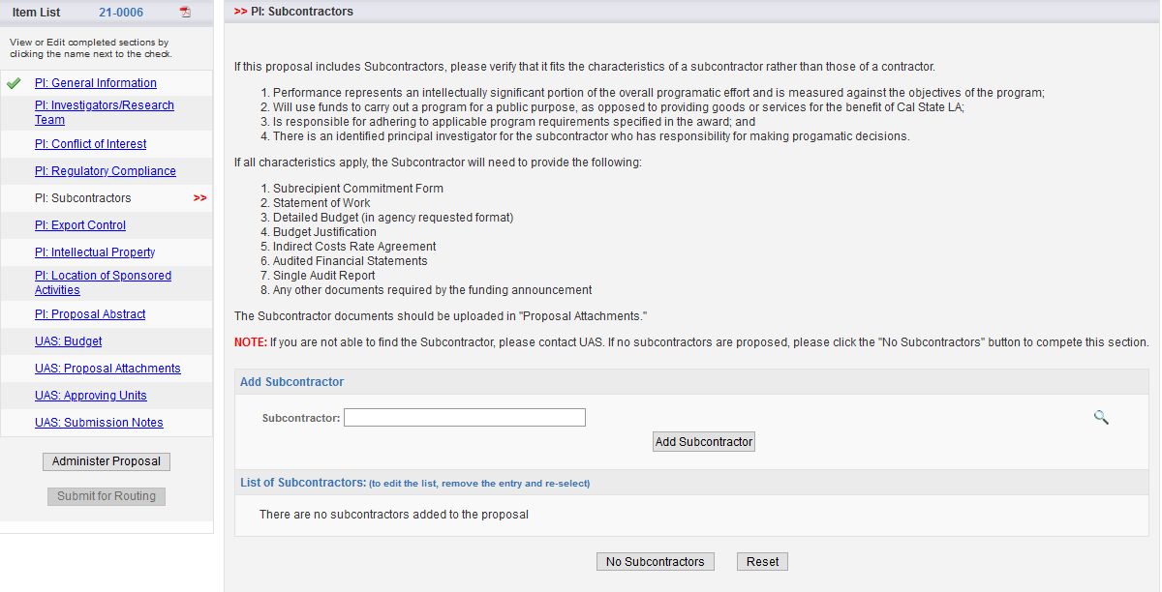
Subcontractors
Verify that it fits the characteristics of a subcontractor rather than those of a contractor.
Work with the Subcontractor to gather the required Subcontractor proposal documents.
If there are no subcontractors, select “No Subcontractors.”
Click to search for subcontractor. If sub is not included on the list, please contact Ernesto Argumaniz (eargumaniz@calstatela.edu) or Rowynn Spencer (rspencer@calstatela.edu) and they can add the subcontractor for you.

Slide 13
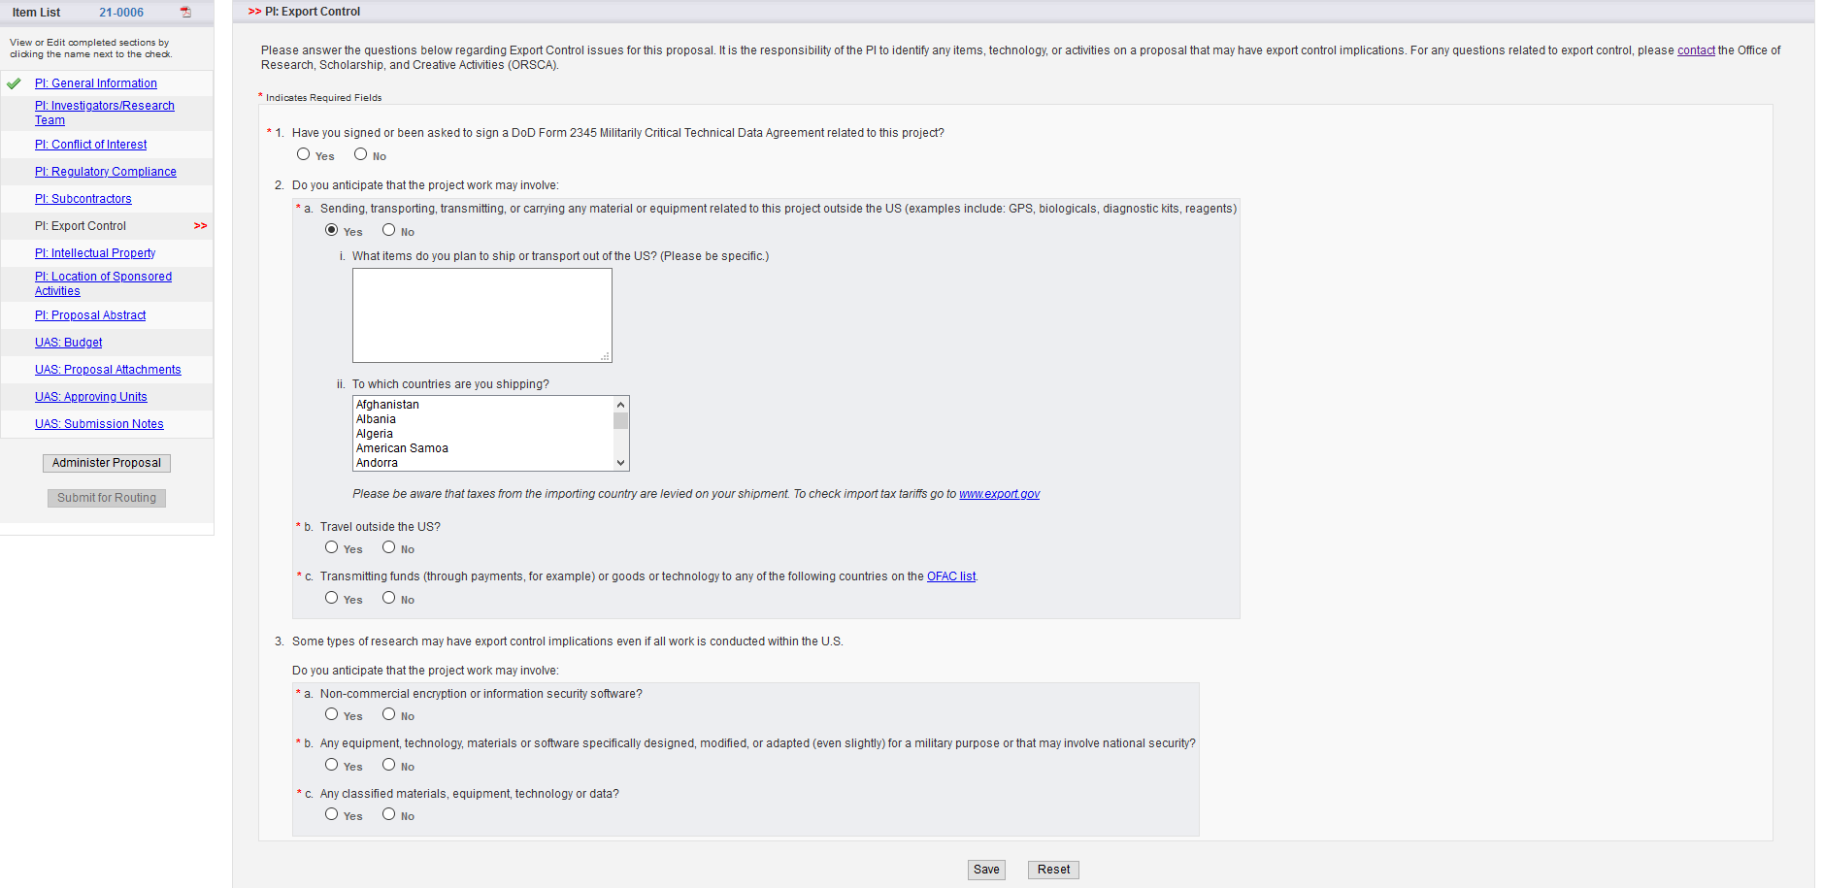
Export Control
Answer the questions regarding Export Control issues for this proposal.
Save to Move Forward!

Slide 14
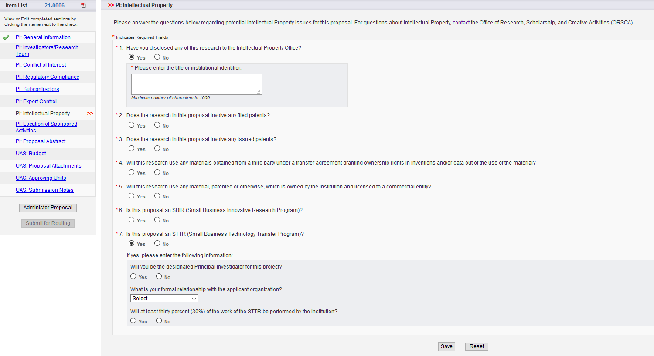
Intellectual Property
Answer the questions regarding potential Intellectual Property issues for this proposal.
Save to Move Forward!

Slide 15
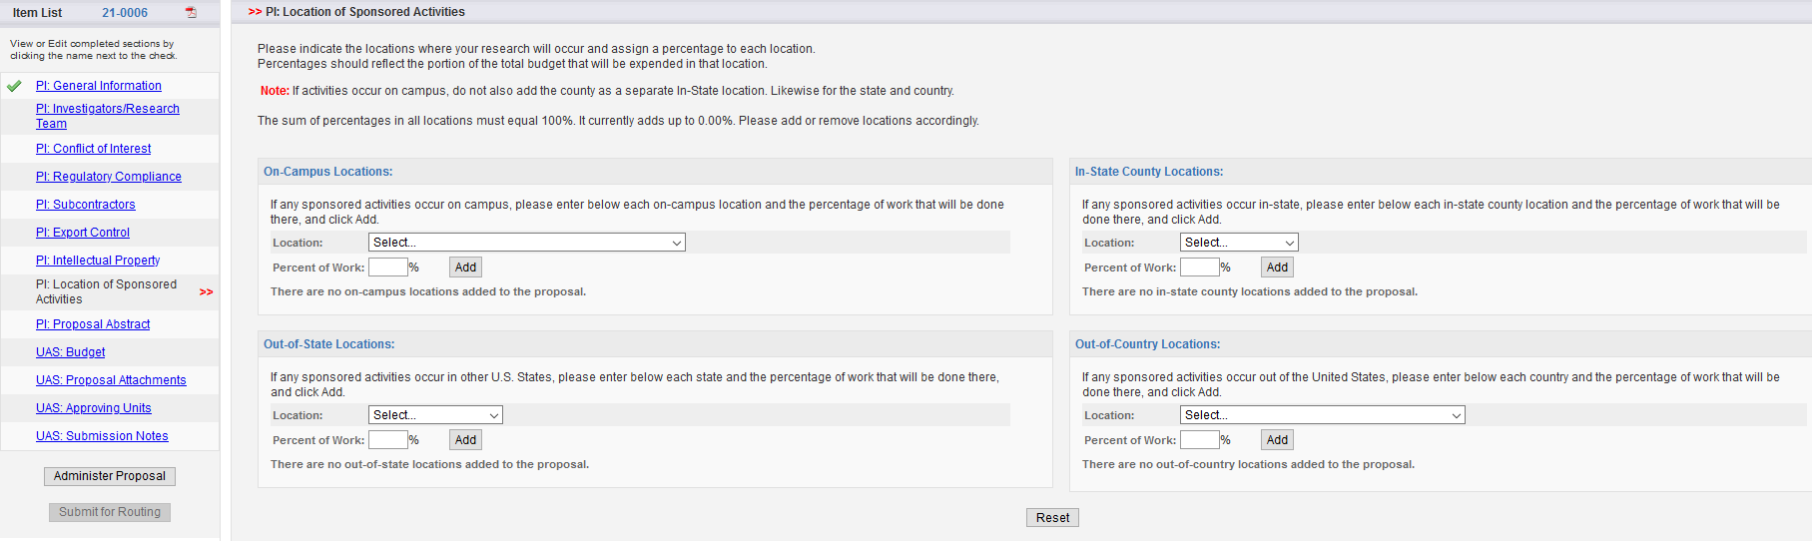
Location of Sponsored Activities
This section serves as the place to indicate where your research will occur. You will assign a percentage to each location. Percentages should reflect the portion of the total budget that would be expended in each location.
The sum of percentages in all locations must equal 100%.

Slide 16
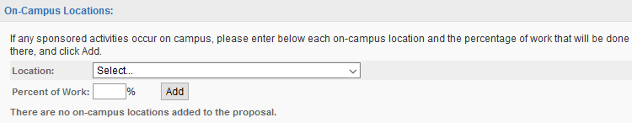
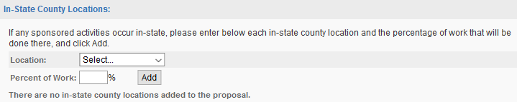
Location of Sponsored Activities
On-Campus Locations: Enter specific campus location(s) where research will be conducted. Be as precise as possible.
In-State County Locations: From the drop-down menu, select the county or counties in which sponsored activities will occur. Select one county at a time to add several counties.

Slide 17
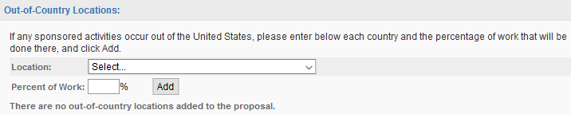
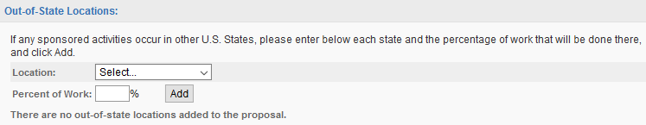
Location of Sponsored Activities
Out-of-Country Locations: From the drop-down menu, select the country or countries in which sponsored activities will occur. Select one country at a time to add several countries.
Out-of-State Locations: From the drop-down menu, select the state(s) in which sponsored activities will occur. Select one state at a time to add several states. You can also select the special entry "All States" if work will occur in all states.

Slide 18
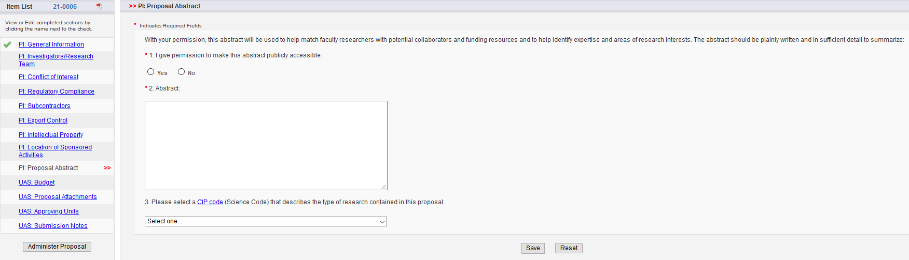
Proposal Abstract
This permission authorization is regarding internal Cal State LA permissions only.
Please enter Abstract/Summary.
Select the Science Code for this proposal that describes the type of research.
Save to Move Forward!

Slide 19
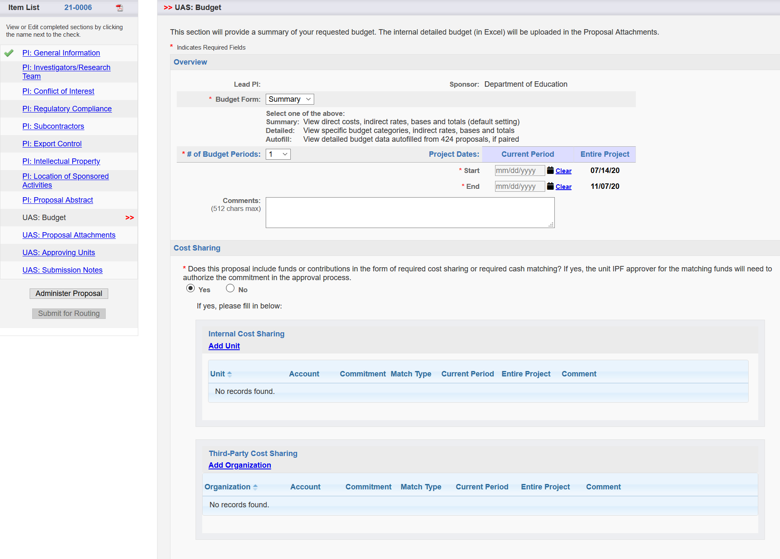
Budget
The internal detailed budget (in Excel) will need to be completed.
Number of years in the project.
Performance period of Current Period
Performance period of Entire Project
Cost Share: If cost-share is required, select “Yes”
Cost Share: If cost-share is internal, include the unit (Department or College) that will authorize the cost share commitment.
Cost Share: If cost-share is external, include the Organization’s Name and amount committed. Cost-share commitments from Third Parties must be requested and uploaded in the “Proposal Attachments” section.

Slide 20
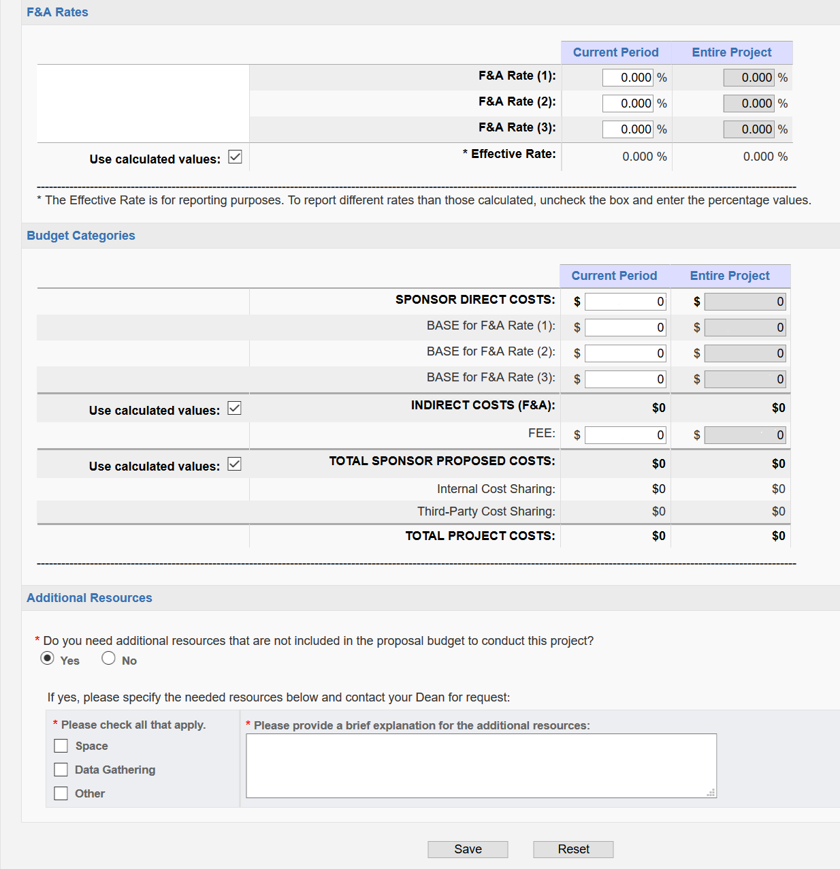
Budget
Click the F&A Rate to choose the appropriate indirect rate for the project.
Sponsor Direct Costs: Direct Costs of Current and Entire Project
Base for F&A Rate: Modified Total Direct Costs of Current and Entire Project
If Yes, choose resource(s) from the list and provide explanation.
Save to Move Forward!

Slide 21
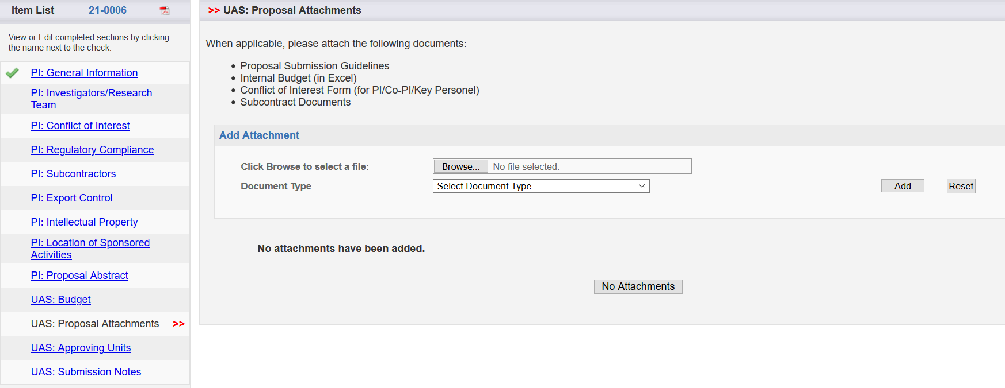
Proposal Attachments
All final documents associated with the proposal should be uploaded to this section

Slide 22
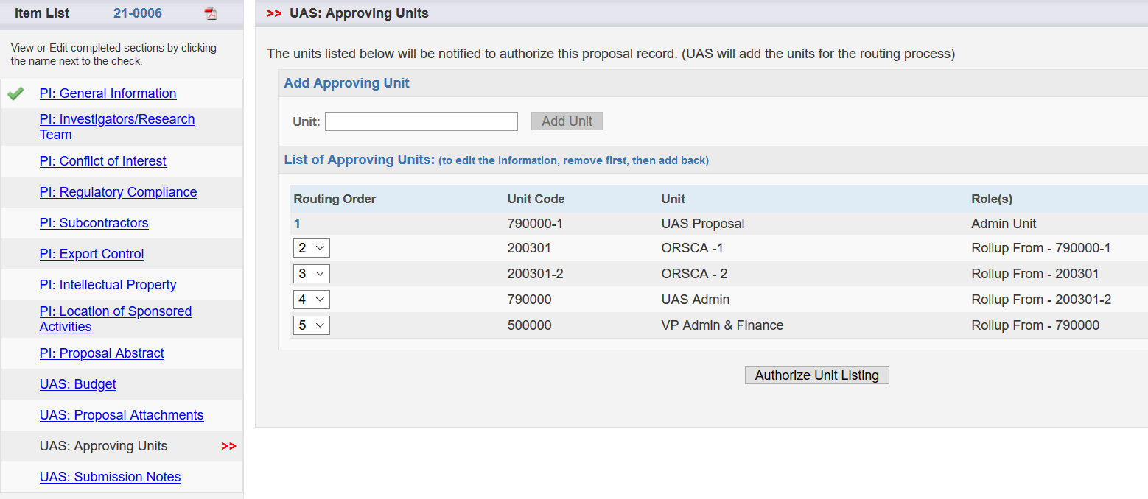
Approving Units
Units: The faculty’s Departments, Colleges, Centers, etc. involved in the project should be included in the routing process. They are automatically added when the “Investigators/Research Team” is completed.
Authorize Unit Listing: Review Approving Units list above. If the list appears correct, click Authorize Unit Listing. If the list appears to be incorrect, please contact Ernesto Argumaniz (eargumaniz@calstatela.edu) or Rowynn Spencer (rspencer@calstatela.edu) for assistance.

Slide 23
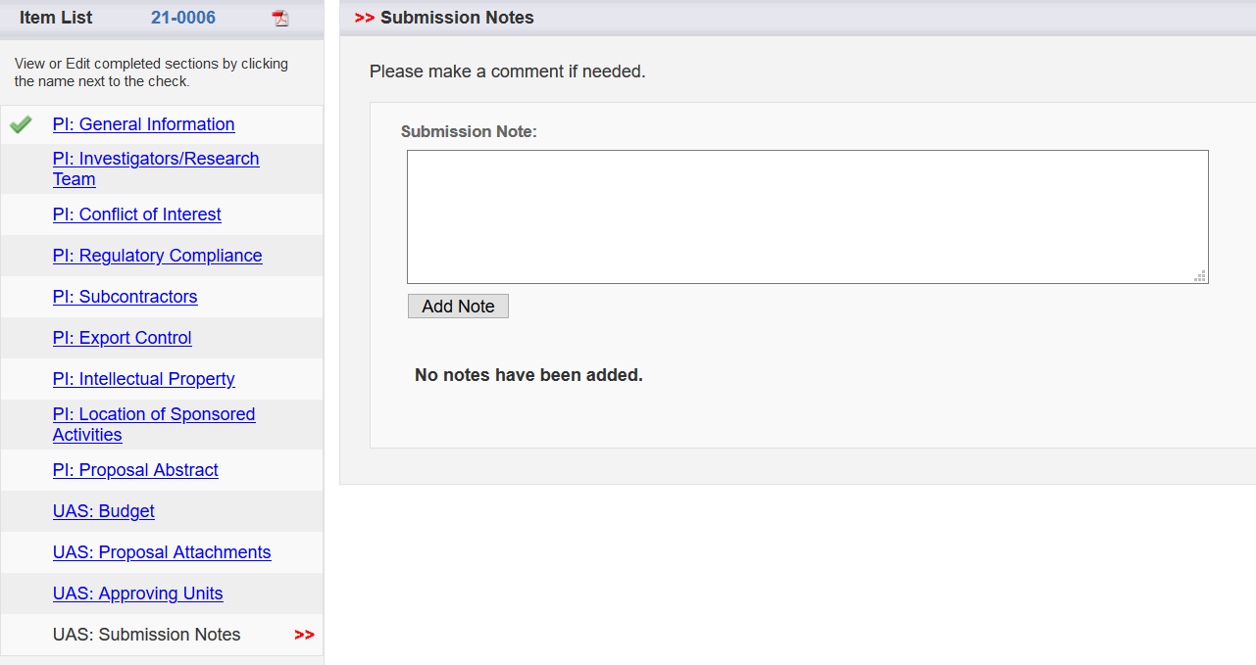
Submission Notes
If applicable, you can include a comment or note for this proposal. If no comment, leave blank. All comments can be viewed by all in the routing process (faculty, Chairs, Deans, etc.)

Slide 24
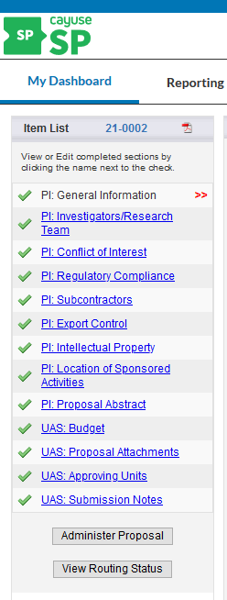
A completed Item List will appear as follows when all the required items have been completed and the internal routing process can be initiated. Please contact please contact Ernesto Argumaniz (eargumaniz@calstatela.edu or Rowynn Spencer (rspencer@calstatela.edu) when you are ready to route your proposal.

Slide 25
Please remember to contact the UAS Office Sponsored Programs (OSP) Pre-Award Administration at any time if you need assistance.
Rowynn Spencer, Senior Pre-Award Grant & Contract Analyst, ext. 3-3824, rspencer@calstatela.edu
Ernesto Argumaniz, Corporate Contracts Manager, ext. 3-6027, eargumaniz@calstatela.edu

