Slide 1
Office Sponsored Programs (OSP) Pre-Award Administration
Cayuse SP Instructions for Review of Proposals by Lead Principal Investigator, Co-Investigators, Senior Personnei

Slide 2
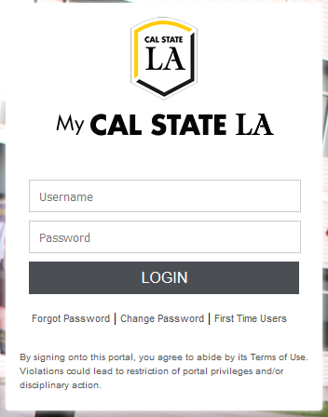
Cayuse Login: https://uascalstatela.cayuse424.com/
Username: Your Cal State LA ID (eg. LastName123)
Password: Your single sign-on Cal State LA password

Slide 4
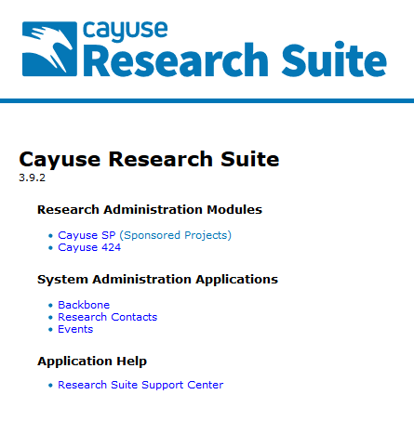
Click the
Sponsored Projects
link

Slide 5
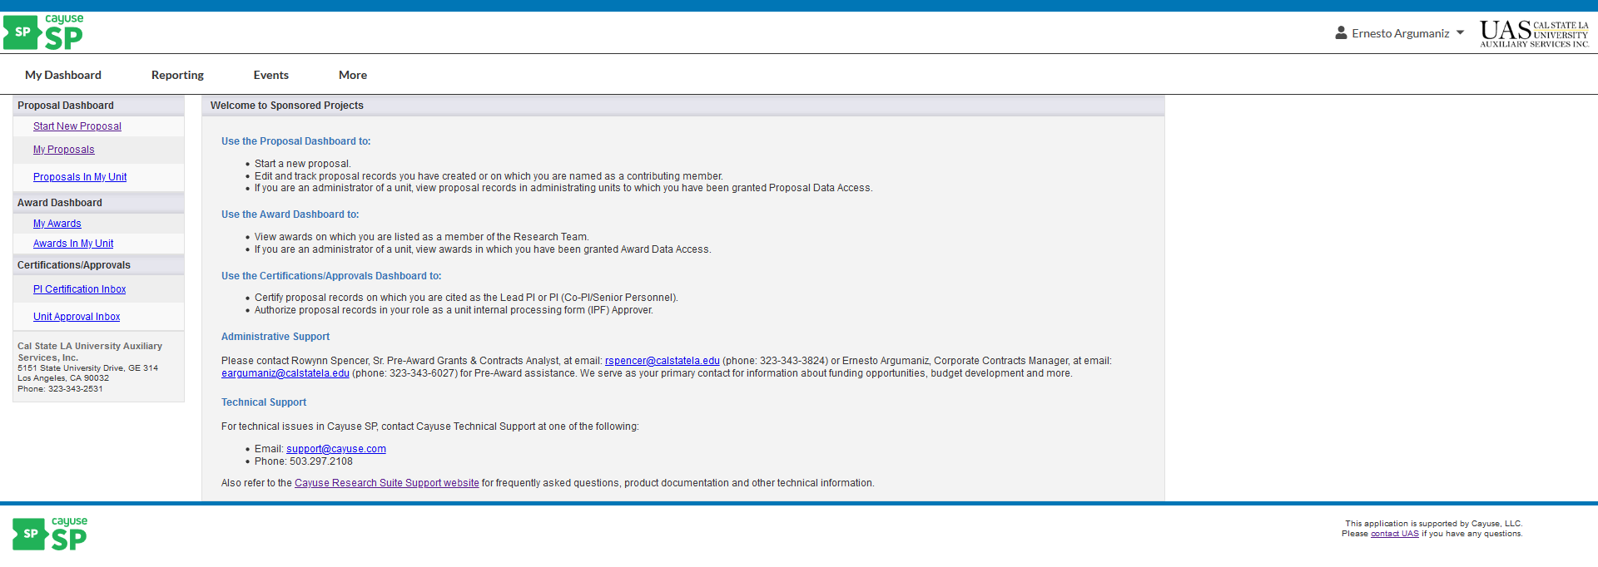
If you are a Principal Investigator on a proposal, you can certify the Approval Form once it has been submitted for routing. In Cayuse SP, the Lead PI and other Principal Investigators have the authority to certify. You will know if you have any Approval Forms awaiting certification if you see a number next to the PI Certification Inbox. You will also be notified via email when an Approval Form is in need of certification.

Slide 6
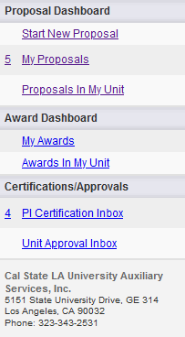
Certifying a Proposal
In the left-hand menu, click on PI Certification Inbox

Slide 7
Beneath the To be Certified tab, click on the proposal number of the proposal you need to certify.

Slide 8
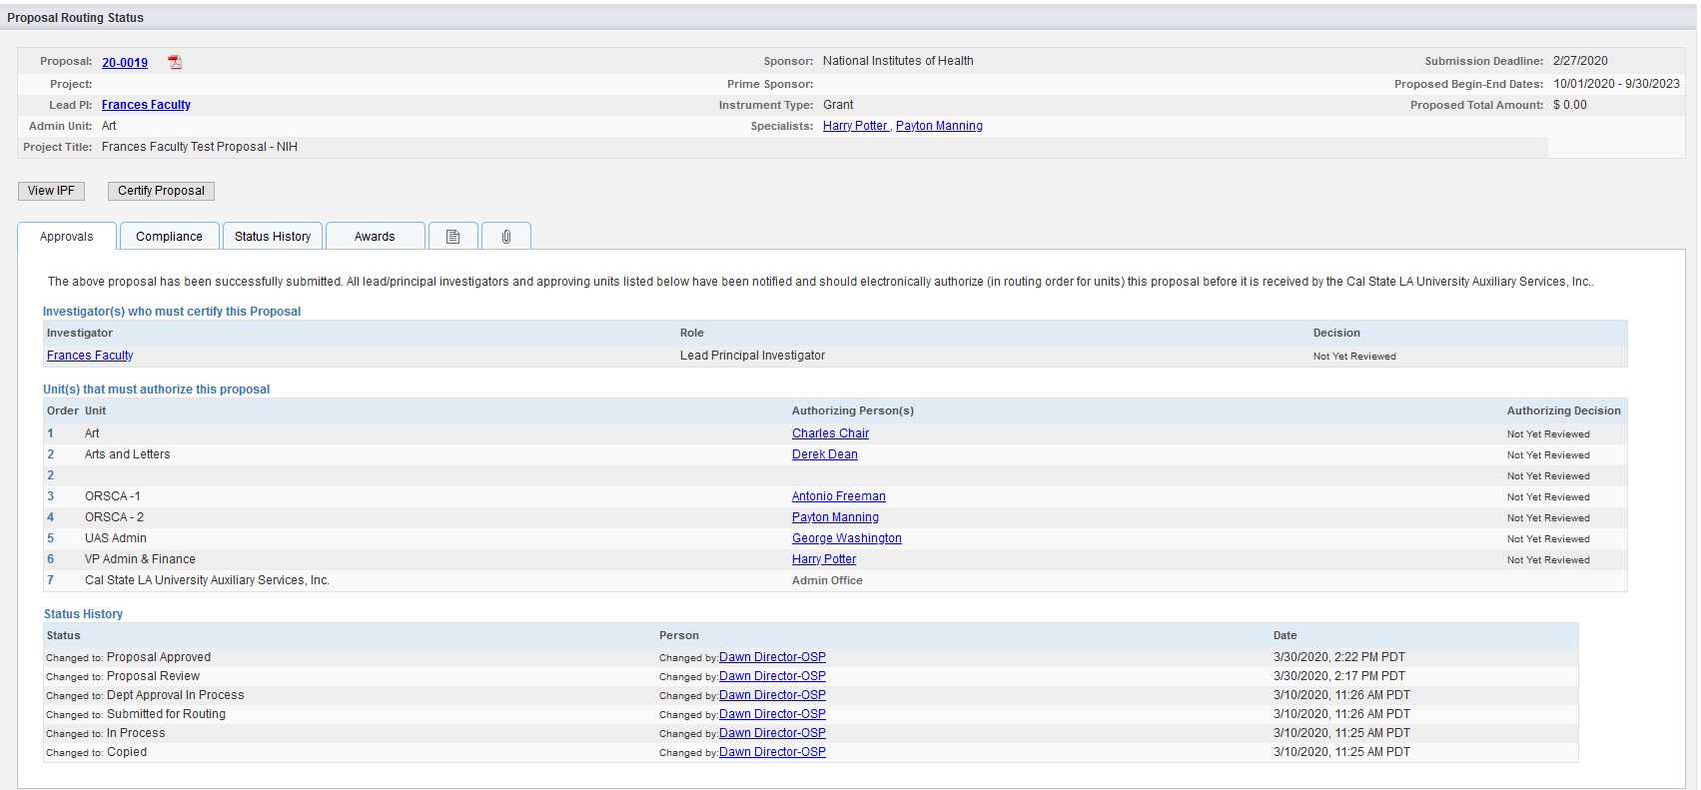
Review the Approval Form by clicking on the PDF icon or proposal number.

Slide 9
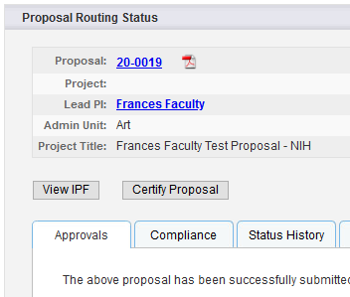
After you have reviewed the proposal, click on Certify Proposal beneath the Item List or on the Proposal Routing Status screen.
Enter comments you have regarding the proposal. These will be visible to the Research Team, proposal reviewers, and the UAS Office Sponsored Programs (OSP), Pre-Award Administration.
Click Submit Certification to acknowledge the certification statement.

Slide 10
Please remember to contact the UAS Office Sponsored Programs (OSP) Pre-Award Administration at any time if you need assistance.
Rowynn Spencer, Senior Pre-Award Grant & Contract Analyst, ext. 3-3824, rspencer@calstatela.edu
Ernesto Argumaniz, Corporate Contracts Manager, ext. 3-6027, eargumaniz@calstatela.edu

